Slide 1
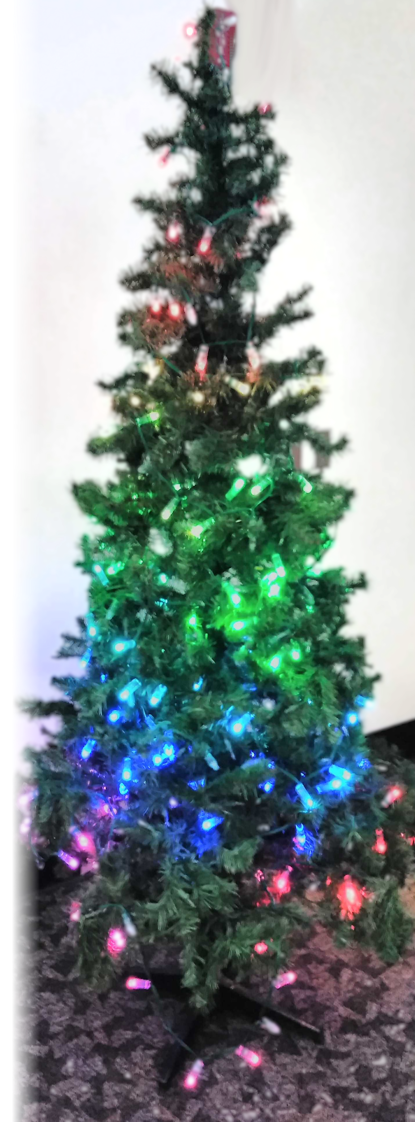
Holiday Lights Project
SDDec19-10
Client : Dr Daniels
Jake Grace | Software Lead
Chad Griggs | Report Manager
Thien Nguyen | Webmaster
Joe Nunez | Meeting Scribe
Valery Smith | Signal Processing Specialist
Steven Williams | Hardware Lead
Notes:
Steve - start. Say what’s up

Slide 2
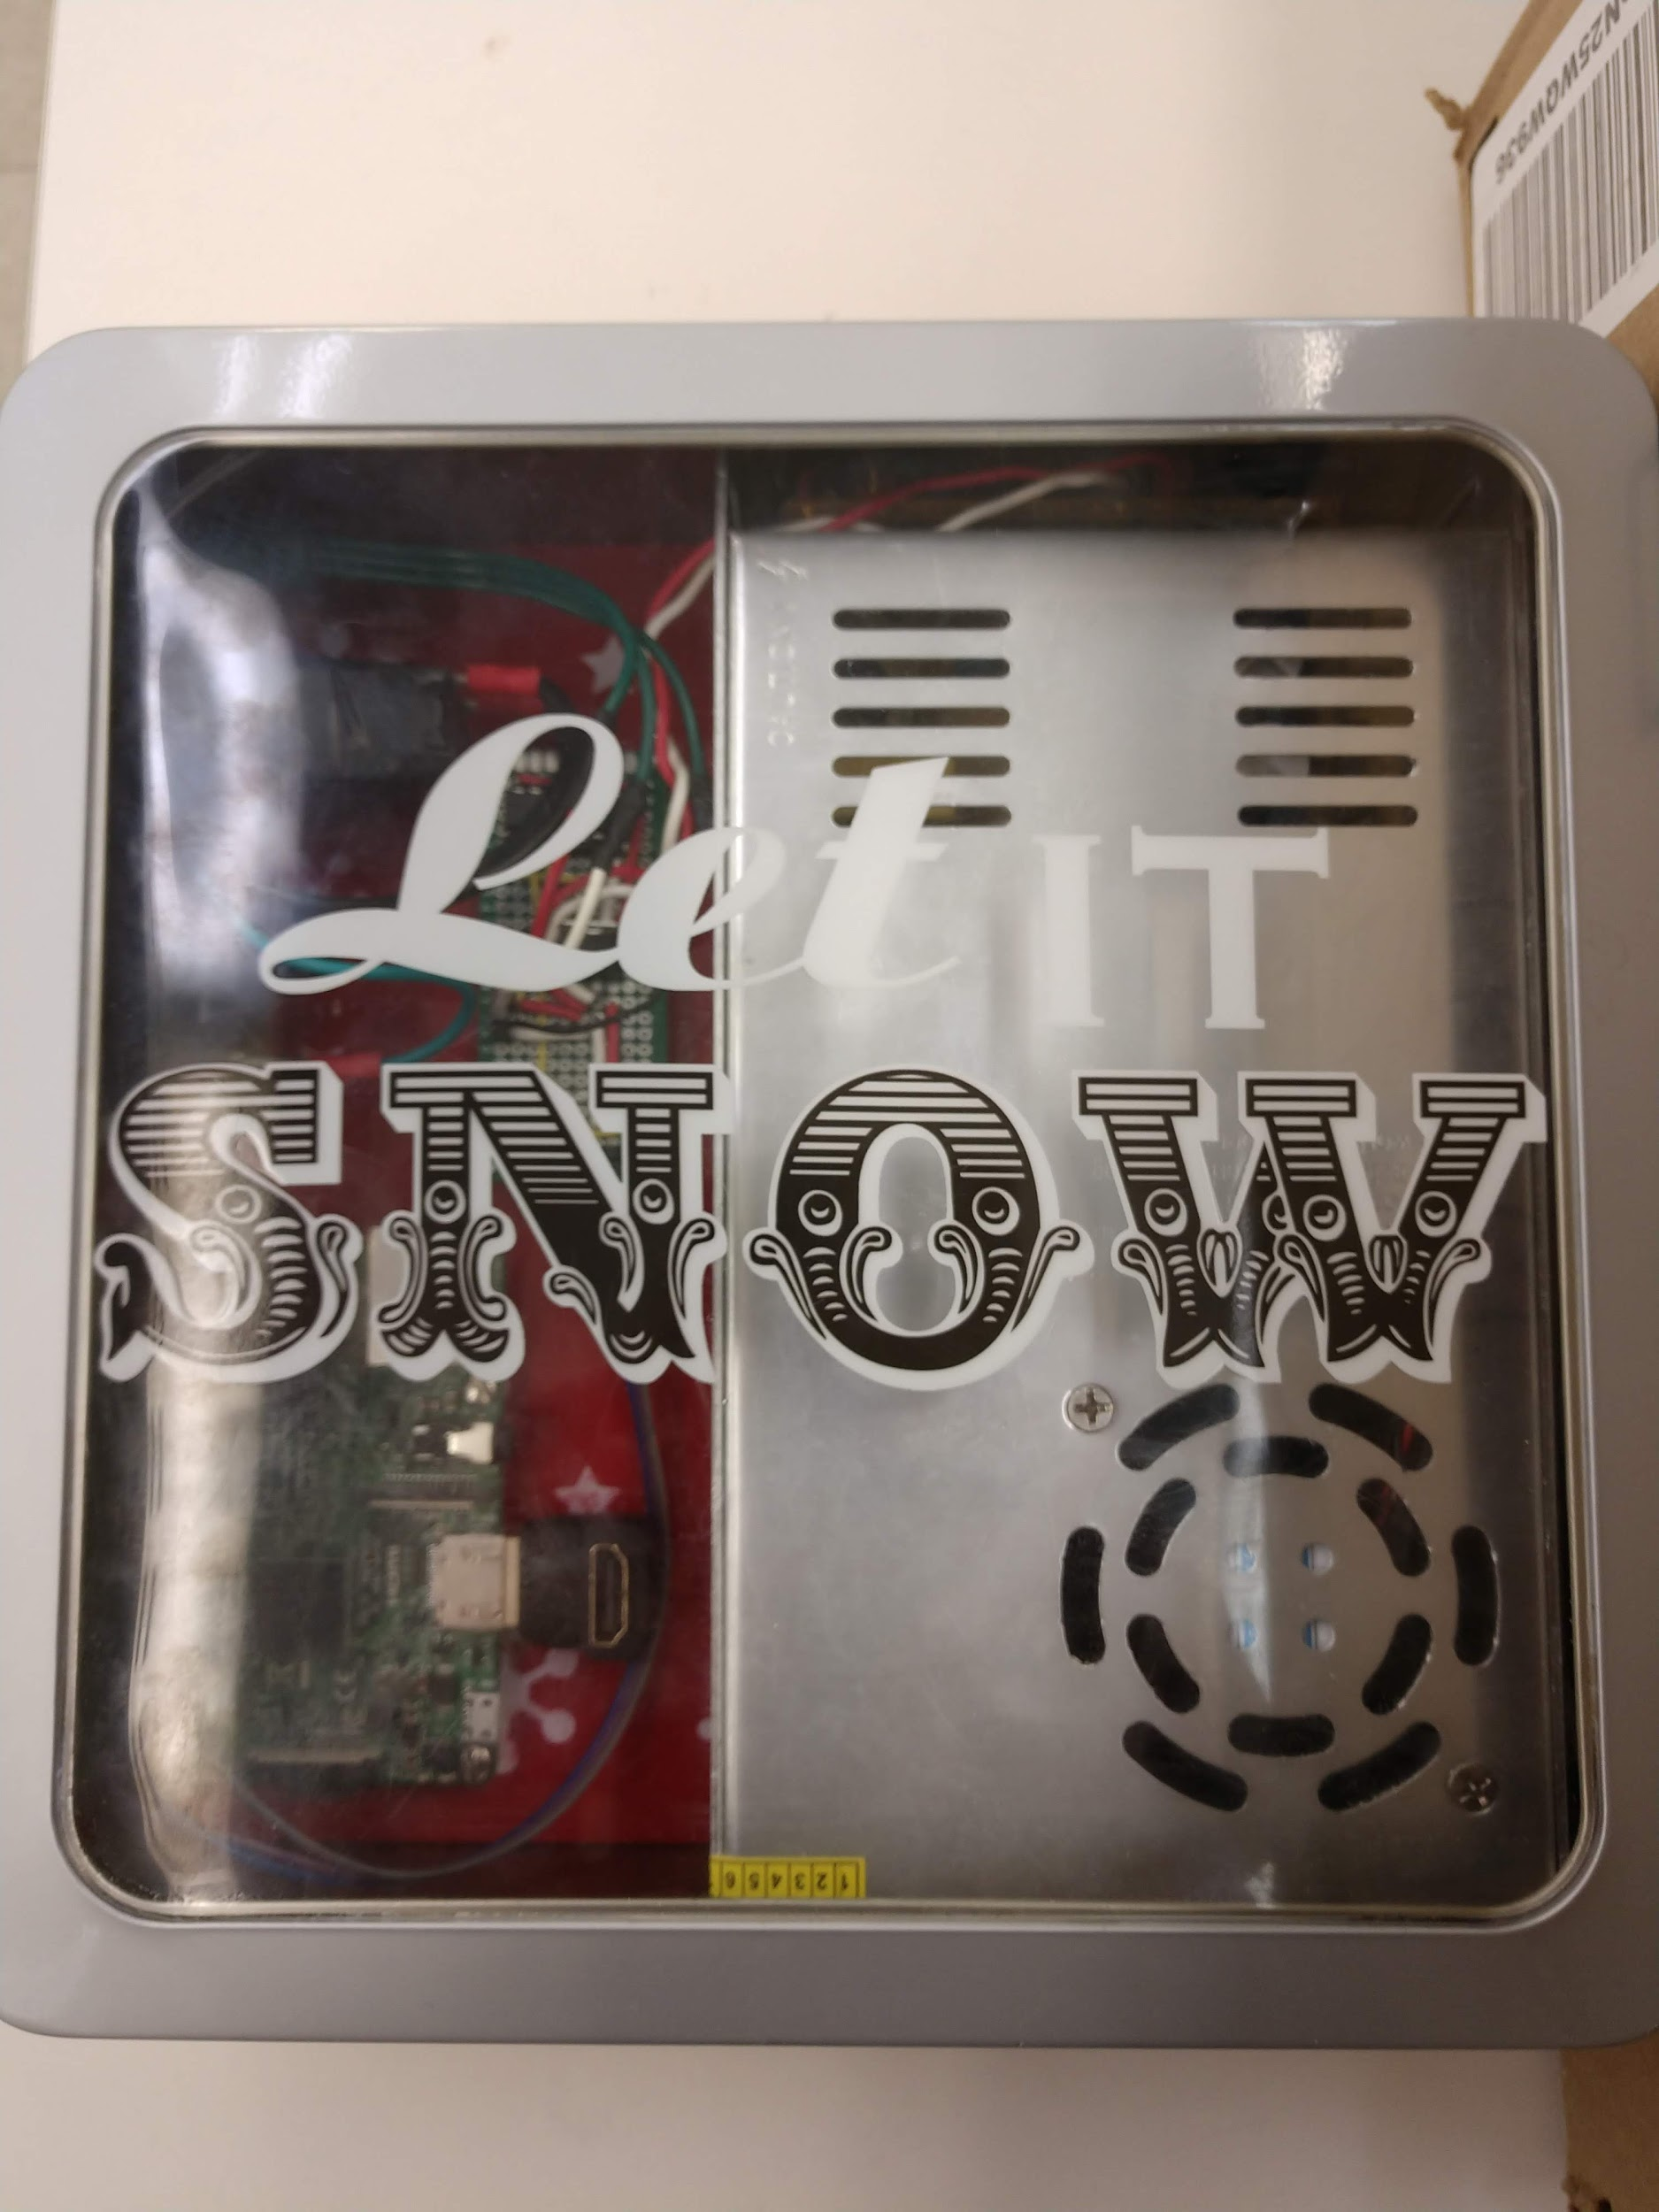
Problem Statement
Major upgrade of current Christmas lights
Create dynamic displays (animations)
Choose and create patterns to display
User Friendly
Continuation of team SDDec18-10 project “Holiday Reverse Programmable Light Strings”
SDDec19-10
Notes:
Chad- Today’s current Christmas tree lights are outdated and have not changed for several years We want to create a new and exciting way to show your Christmas spirit, impress your friends and family, and celebrate the holiday Our product is a major upgrade to the Christmas lights of today Our lights are capable of stunning displays that can change at any time Once the lights are set up, the user can display dynamic images and patterns of their choosing on the tree

Slide 3
Project Deliverables
User Interface
User friendly web-application hosted on its own network
Custom build patterns and animations
Lights and Control Box
Contains Raspberry Pi, power supply, and other necessary circuit components
LED strand to be wrapped around the tree
Calibration Algorithm
Method by which the system will determine the location of each LED
User Manual
Set-up guide, instructions, and proper set-up technique
SDDec19-10
Notes:
Jake
User Interface: The user interface will be a user-friendly web application hosted on our senior design website. We would like to use WebSockets to have the server push events to the pi to control the lights. On the user interface the user can either upload images files to be texture mapped to the LEDs on the tree or design a basic pattern to be displayed such as a rotating rainbow or other select colors.
Lights and Control/Powerbox: The control/power box contains a 12v power supply, a 5v:3v step-down converter, and a Raspberry Pi. The lights are WS2811 LED/chipsets. Python files will be controlling the Raspberry Pi’s PWM pin that is connected to the WS2811 LEDs.
Calibration Method: The method by which the system will determine the location of each
individual LED on the tree. It will utilize camera images captured by a PiCam to be processed on the Raspberry Pi.
User Manual: a pdf detailing how to set-up, calibrate, change designs, and take down the system in an easily readable way. This document will contain diagrams and images to help guide the user.

Slide 4
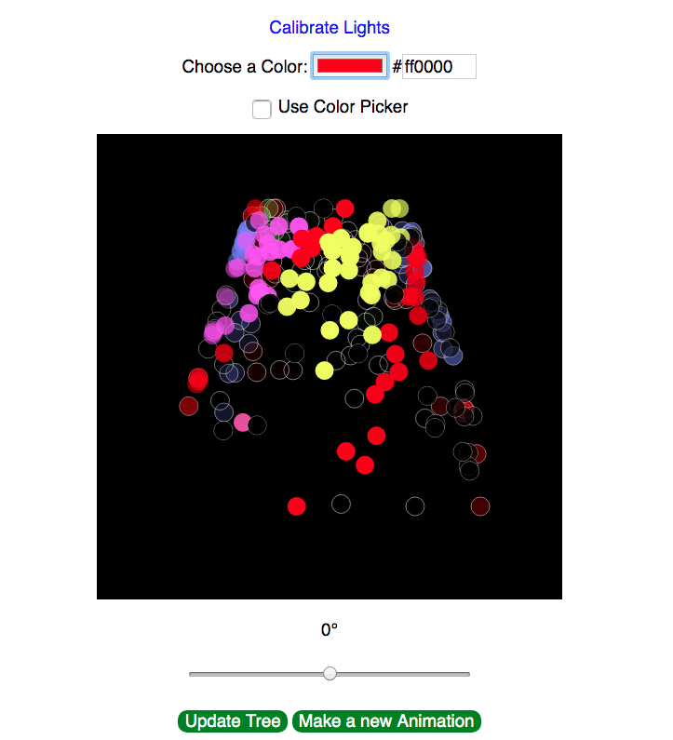
Functional Requirements
The system should:
Display patterns and animations
Semi-autonomously calibrate the individual LEDs
Have a User-Interface application to control the LEDs and Calibration
SDDec19-10
Notes:
Joe -
The system should:
Display patterns and animations that the user can create, save, and load.
The system should be able to calibrate itself semi-autonomously with minimal user input.
It should have a user interface to control the LEDs and function of the tree.

Slide 5
Constraints & Non-Functional Requirements
Constraints
The system as a whole should not be over budget (>$300)
The system should be portable
The system should be easy to use
Non-Functional Requirements
The wireless communication should not be vulnerable
The system should be aesthetically pleasing
The strands of lights should be easily scalable
SDDec19-10
Notes:
TN
NEEDS PICTURE
Can prob go through this quick
We should work under the previous team’s strucutre. That means taking all their hardware components they left behind and any legacy code. It was up to us to keep it and work upon it (saves us time) -- or go straight from scratch. Debatable on which was the right decision -- we kept the hardware (monetary), and ditched software (time)
Example constaints while designing this would be designing the whole thing should be within a reasonable budget for other client -- approximately 300USD. Most of the material resource cost will be coming up within a following slide.
The item itself should be portable. You should be able to carry it across your house -- the container and the strand of lights are light weight enough (you don’t need to bring a tree) -- and can bring the lights elsewhere/wrapped.
Easy to use -- so simple a child can understand it. Jokes aside, the client should be easy to understand the process to set it up without having a specialist set it up for him -- an easy to read manual, calibration -- a lot of automation can be involved in this step.
---
Non-Functional.
The wireless communication, because it broadcasts itself, its very possible that outside people can connect to the device and upload unwarranted pictures or hijack into the persons local network. We would need to find aform of security (SSH) or even a simple password.
Strand of lights
Easily Expandable. -- The pi should be able to adapt to the amount of lights/details on the image.

Slide 6
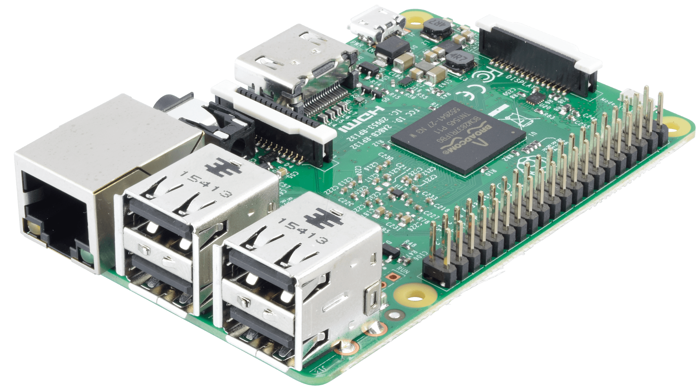
Technical/Other Considerations
Raspberry Pis
Camera
Server
Hardware Safety and Security
Lock down SSH, Wifi, and Pi login credentials
Fire, shock, choking hazards should be mitigated
Software
OpenCV, pyswarm for calibration
Adafruit NeoPixel LED strip library
Environment
Indoor use only
SDDec19-10
Notes:
Jake:
SAY WHY RASP PIs

Slide 7
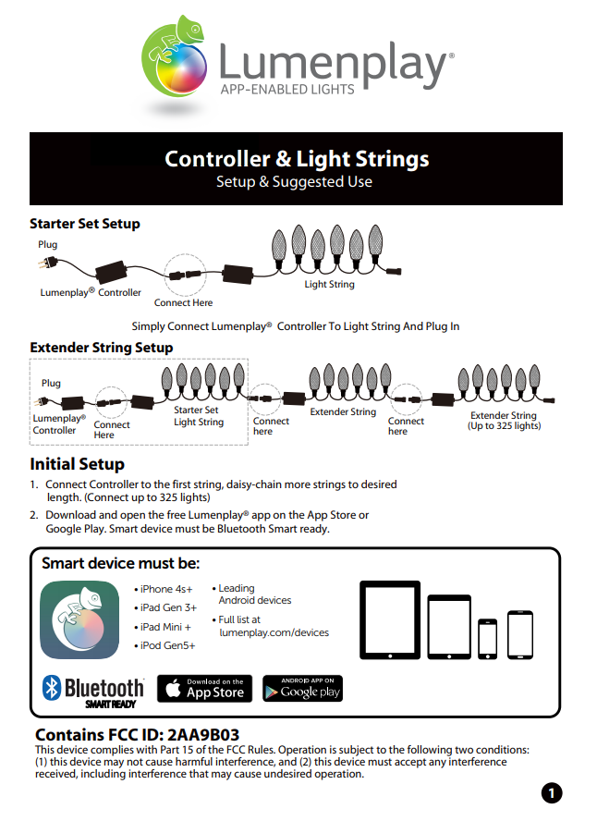
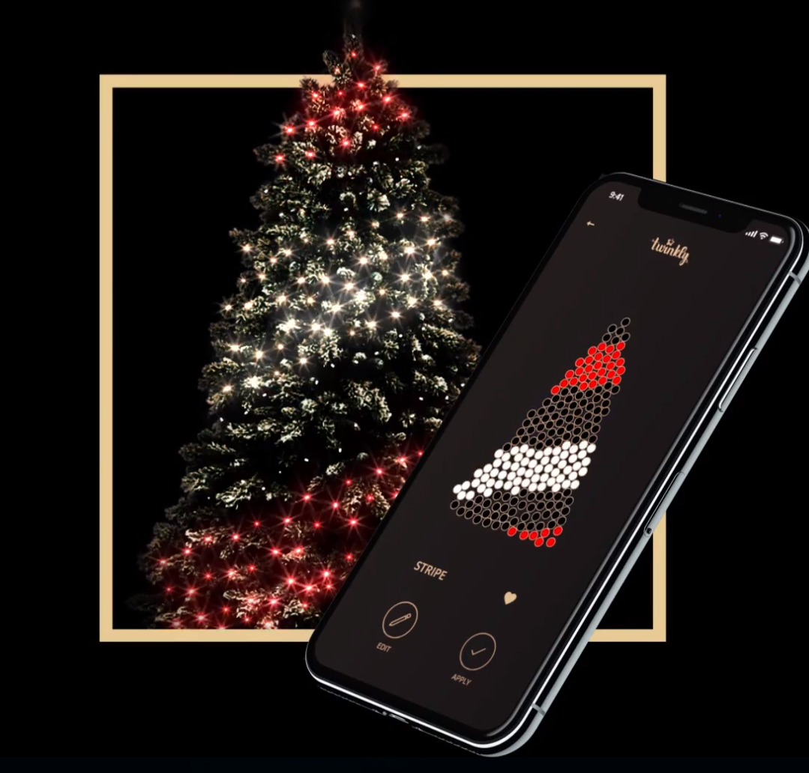
Market Survey
Twinkly
LumenPlay
We are cross-platform and open source
SDDec19-10
Notes:
TN - Niche market, few other competitors Advantage of ours is completely customizable (open source), uses web interface rather than app (requires no external software)
Our market is more pointed toward the hobbyist rather than the tech illiterate LUME PLAY ONLY APPLE
TWINKLY ONLY ANDROID ABILITY TO SCALE TO IMAGE MAPPING AND TEXTURE MAPPING

Slide 8
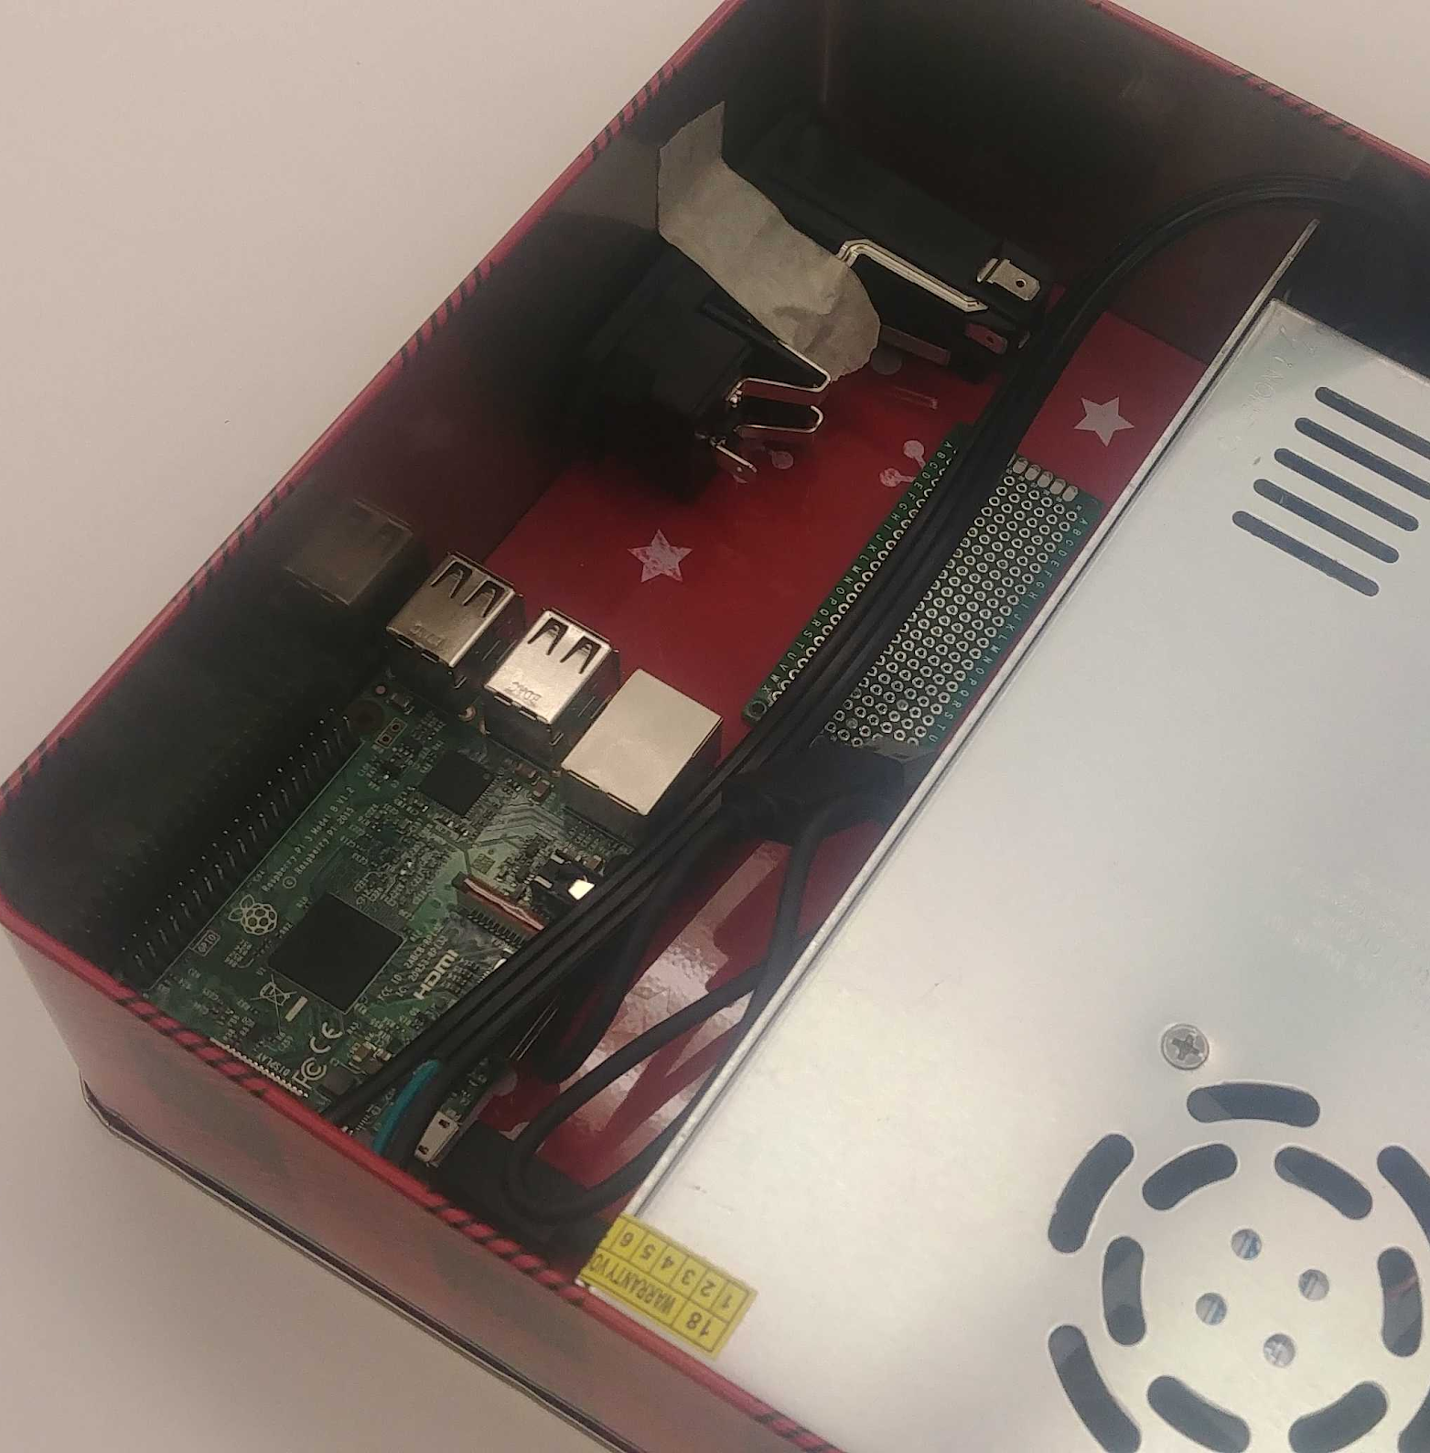
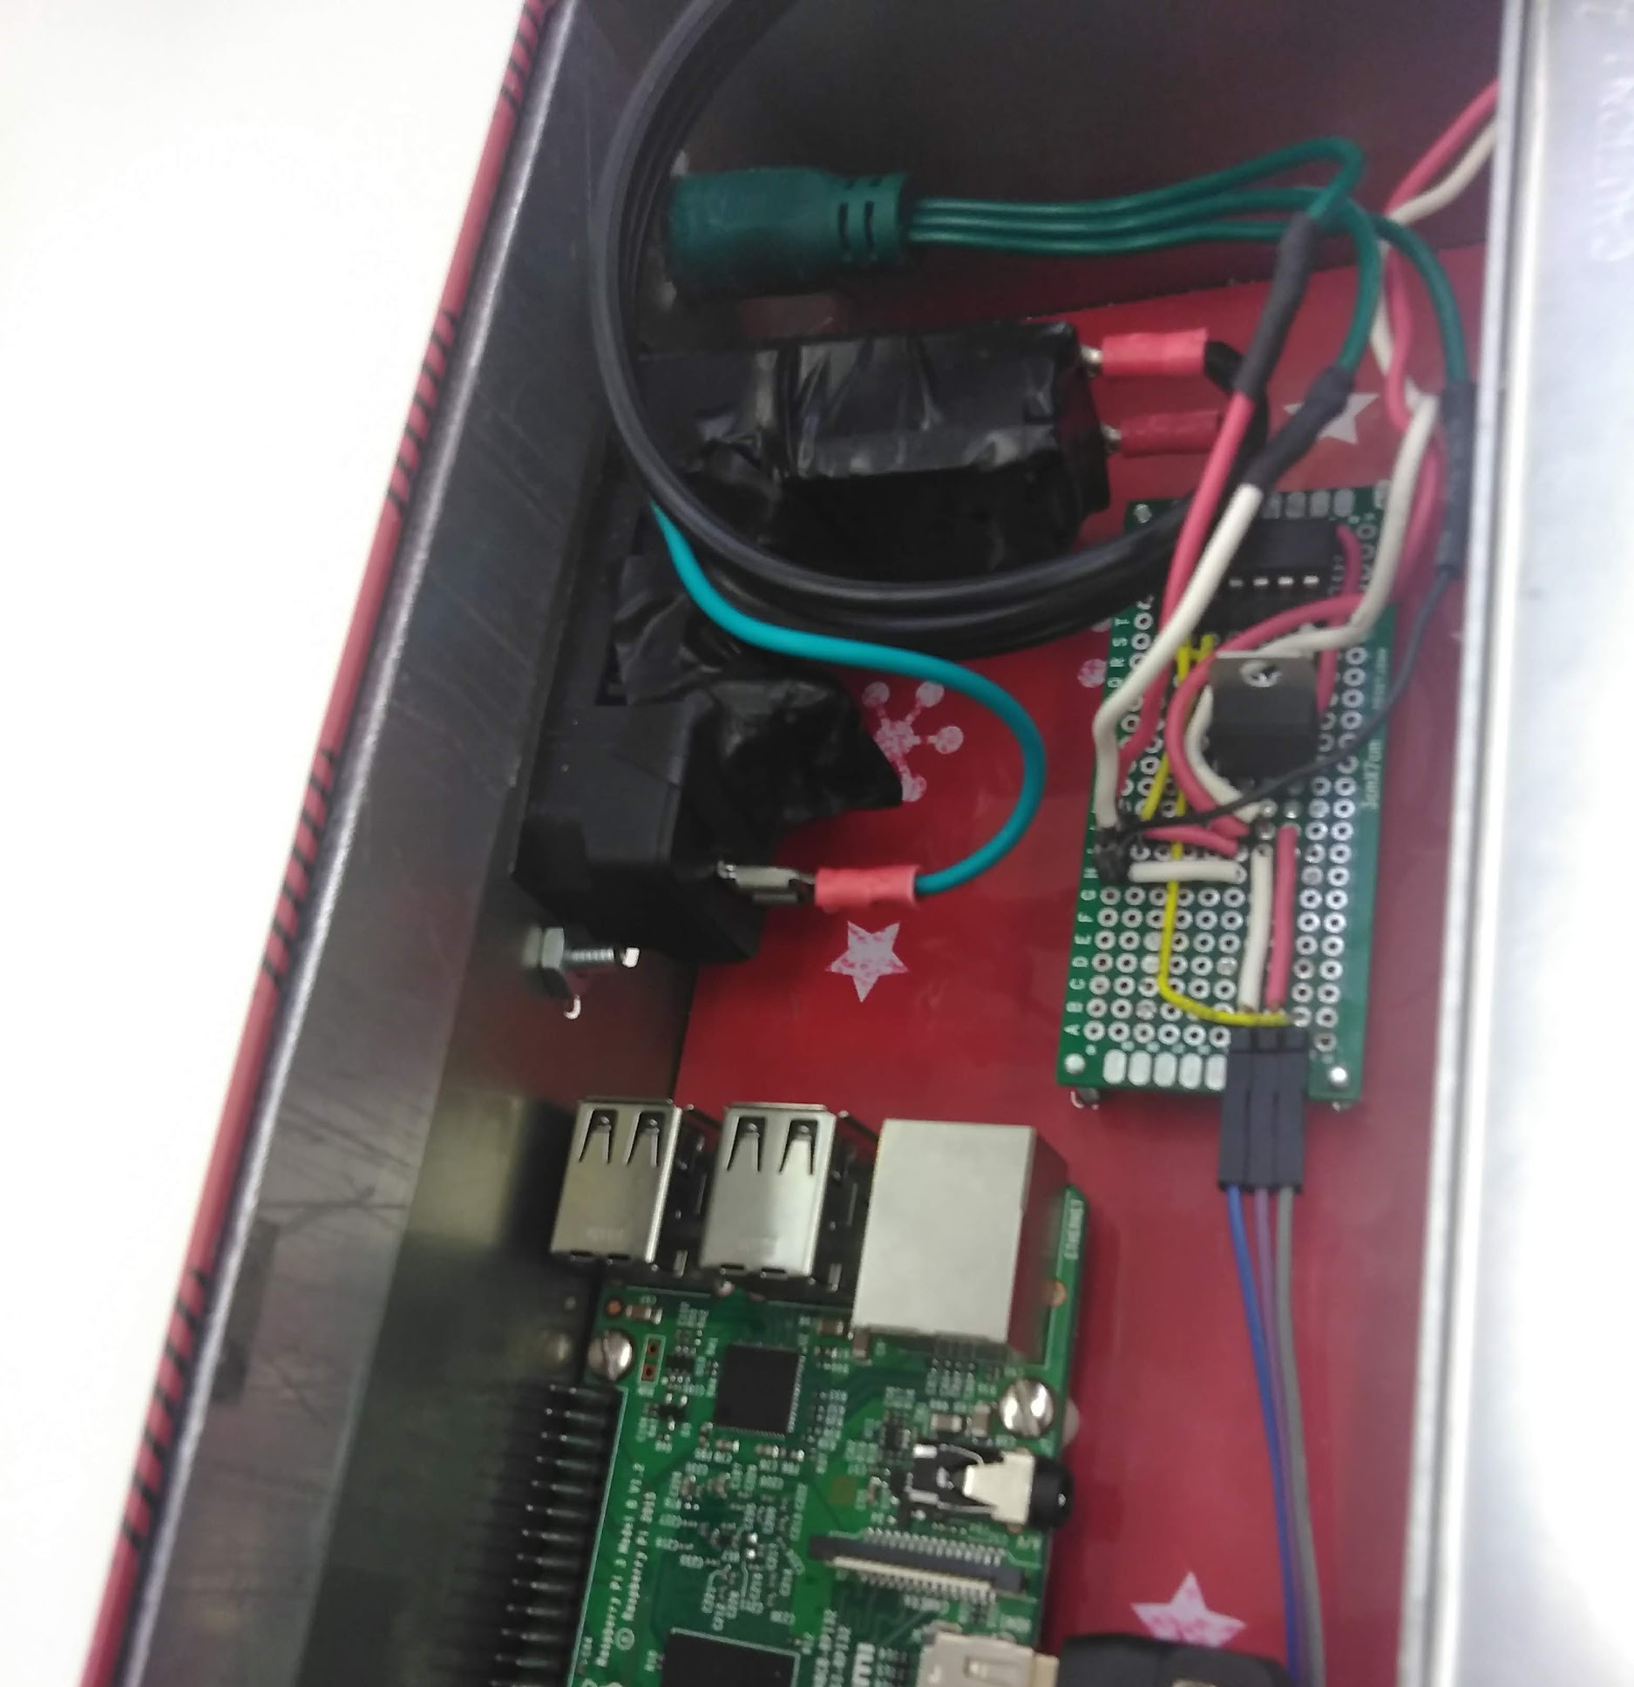
Potential Risks and Mitigation
Software:
Calibration Inaccuracies
OpenCV
Python
Hardware:
Electric Shock
Fire
Burning out LEDs or the Pi
SDDec19-10
Notes:
Joe
On the software side, some risks include:
Calibration inaccuracies, we’ll touch on this later.
OpenCV
Inexperience with python
For hardware, the risks were:
Electric shock
Fire
Burning out LEDs or the Pi.
To mitigate these concerns, we took proper steps to thoroughly ventilate the Tree Pi container and by using a regulated 12v power supply and isolating the lines to keep shorts from occurring.

Slide 9
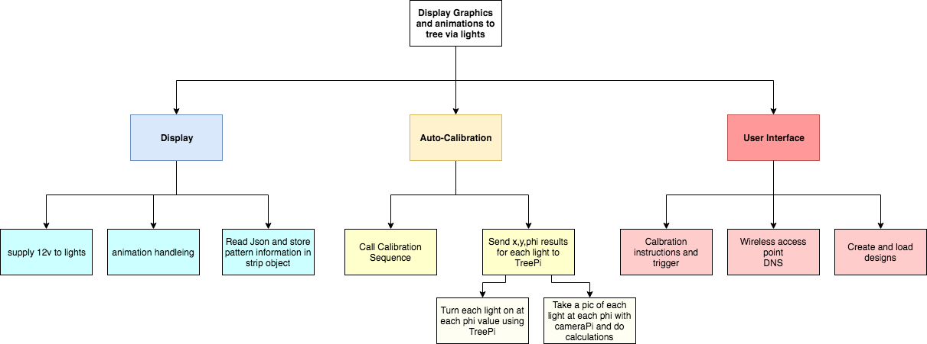
Functional Decomposition
SDDec19-10
Notes:
Val

Slide 10
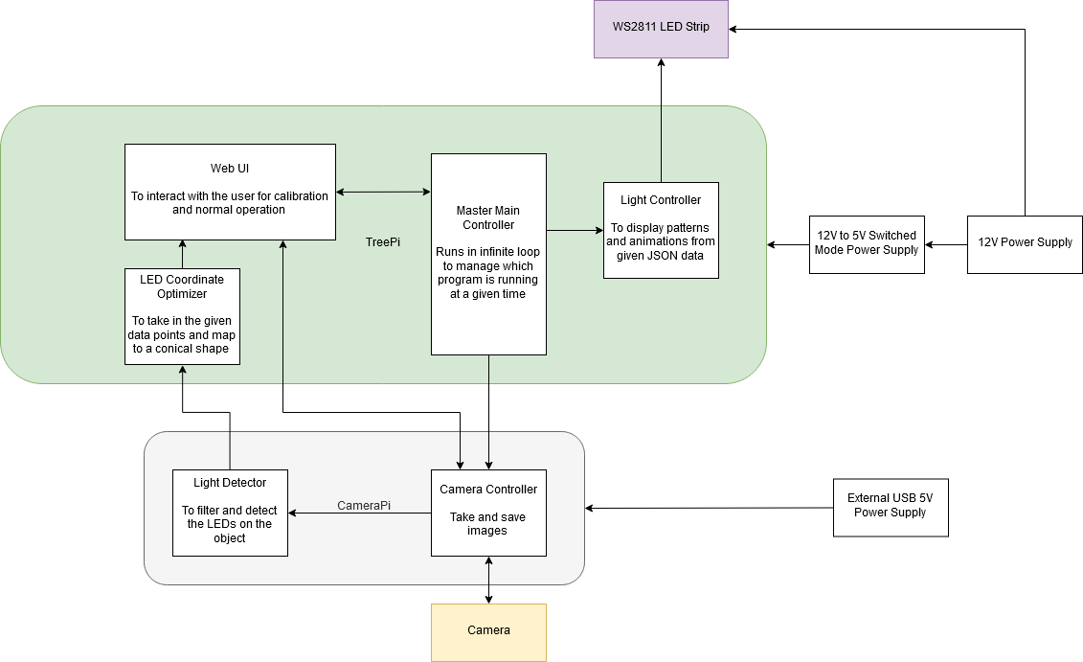
Detailed Design
SDDec19-10
Notes:
Steve - everything is in python except for web ui which is in php, web suite (html, css, js)

Slide 11
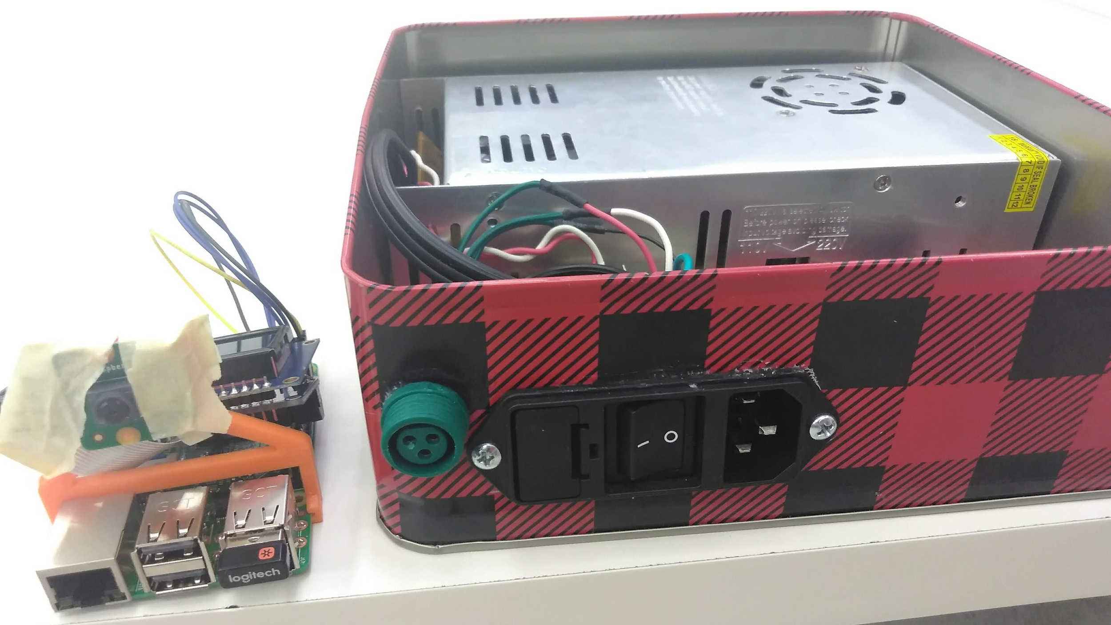
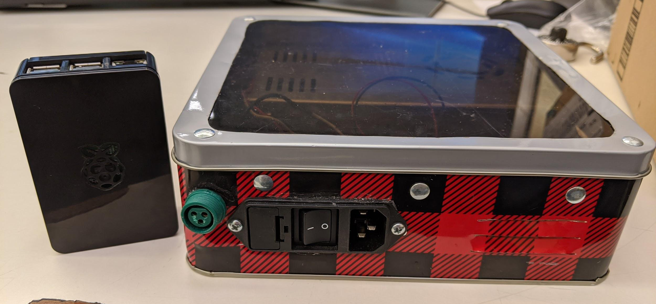
Hardware platforms used
Hardware:
Raspberry Pi
Pi Camera V2
12V 30A power supply
LM2596 - 12V to 5V buck converter
LED light strand (WS2811 chip)
Lazy Susan
SDDec19-10
Notes:
Chad
Raspberry Pi - camera pi will do all the image processing and then send the calibration file to the control pi
Pi Camera V2 - easier than using a users cell phone, allows more control protects against variability in users phones
LM2596 - 12V to 5V buck converter
LED light strand (WS2811 chip) - chip used inside LEDs, drives 3 LEDs at 12V. Latches first 24 bits and sends PWM bitstream to next chip
12V 30A power supply - LEDs expected to use max of 45W or 3.75A, full brightness, all white. Pi recommends max 2.5A, shouldn’t come close to that
Lazy Susan - allows the tree to be easily spun for calibration

Slide 12
Hardware platforms used
Hardware:
Raspberry Pi
Pi Camera V2
12V 30A power supply
LM2596 - 12V to 5V buck converter
LED light strand (WS2811 chip)
Lazy Susan
Two Raspberry Pi model 3 B’s
TreePi - controls LEDs, located inside the box. Runs the light control state machine and acts as wifi access point
CameraPi - takes images and runs calibration process
SDDec19-10
Notes:
Chad
Raspberry Pi - camera pi will do all the image processing and then send the calibration file to the control pi
Pi Camera V2 - easier than using a users cell phone, allows more control protects against variability in users phones
LM2596 - 12V to 5V buck converter
LED light strand (WS2811 chip) - chip used inside LEDs, drives 3 LEDs at 12V. Latches first 24 bits and sends PWM bitstream to next chip
12V 30A power supply - LEDs expected to use max of 45W or 3.75A, full brightness, all white. Pi recommends max 2.5A, shouldn’t come close to that
Lazy Susan - allows the tree to be easily spun for calibration

Slide 13
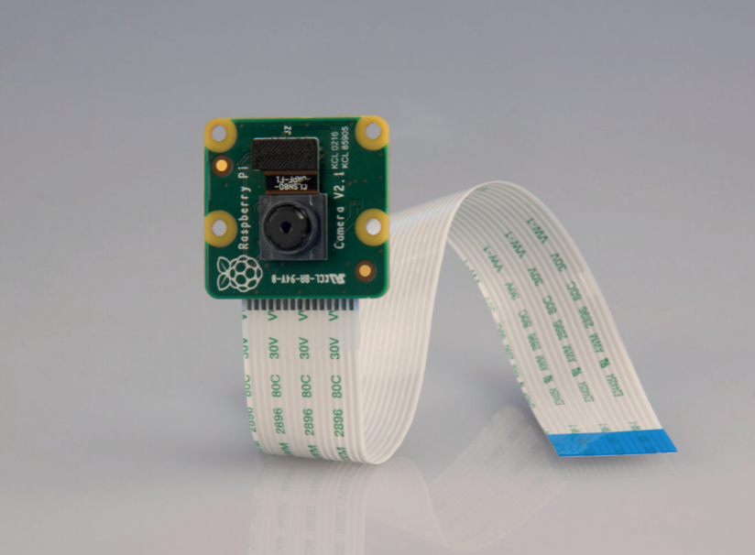
Hardware platforms used
Hardware:
Raspberry Pi
Pi Camera V2
12V 30A power supply
LM2596 - 12V to 5V buck converter
LED light strand (WS2811 chip)
Lazy Susan
8-megaPixel
Capable of 3280x2464 resolution
1080p 30FPS video; 720p 60FPS
15-Pin ribbon cable and dedicated MIPI Camera Serial Interface (CSI-2) port
Much simpler than using an app and a user’s phone
SDDec19-10
Notes:
Chad
Raspberry Pi - camera pi will do all the image processing and then send the calibration file to the control pi
Pi Camera V2 - easier than using a users cell phone, allows more control protects against variability in users phones
LM2596 - 12V to 5V buck converter
LED light strand (WS2811 chip) - chip used inside LEDs, drives 3 LEDs at 12V. Latches first 24 bits and sends PWM bitstream to next chip
12V 30A power supply - LEDs expected to use max of 45W or 3.75A, full brightness, all white. Pi recommends max 2.5A, shouldn’t come close to that
Lazy Susan - allows the tree to be easily spun for calibration

Slide 14
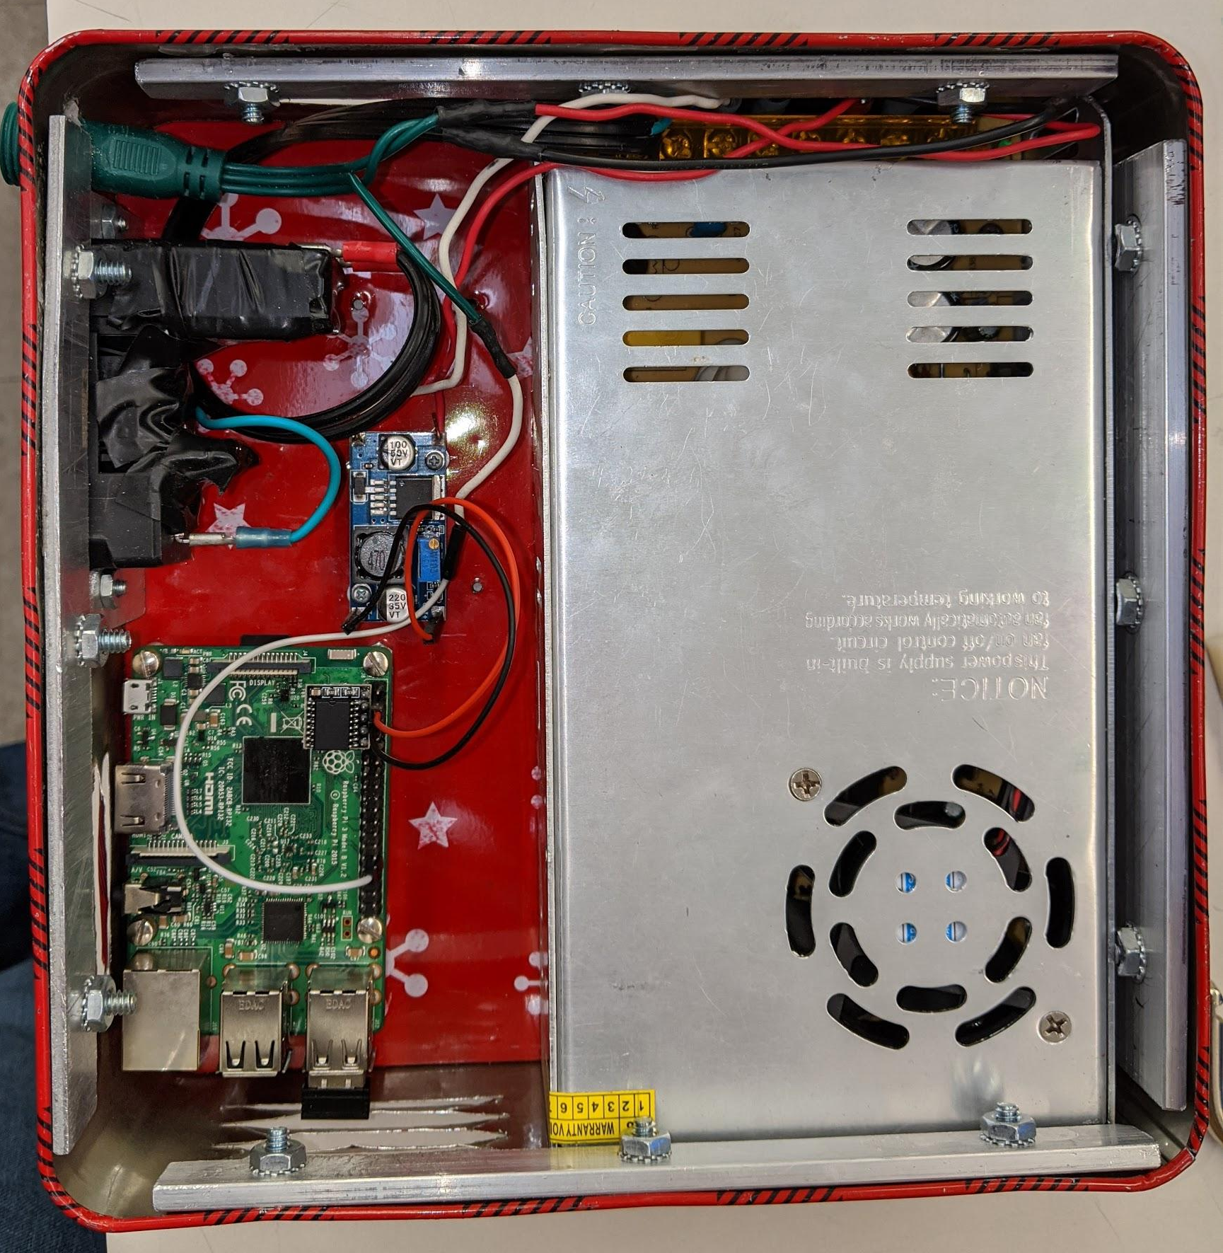
Hardware platforms used
Hardware:
Raspberry Pi
Pi Camera V2
12V 30A power supply
LM2596 - 12V to 5V buck converter
LED light strand (WS2811 chip)
Lazy Susan
Pi Documentation recommends 2.5A PSU
SDDec19-10
Notes:
Chad
Raspberry Pi - camera pi will do all the image processing and then send the calibration file to the control pi
Pi Camera V2 - easier than using a users cell phone, allows more control protects against variability in users phones
LM2596 - 12V to 5V buck converter
LED light strand (WS2811 chip) - chip used inside LEDs, drives 3 LEDs at 12V. Latches first 24 bits and sends PWM bitstream to next chip
12V 30A power supply - LEDs expected to use max of 45W or 3.75A, full brightness, all white. Pi recommends max 2.5A, shouldn’t come close to that
Lazy Susan - allows the tree to be easily spun for calibration

Slide 15
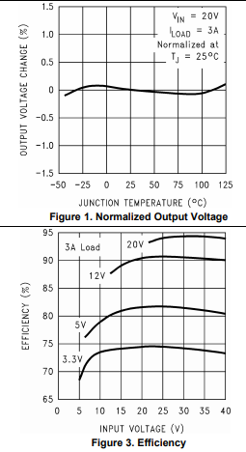
Hardware platforms used
Hardware:
Raspberry Pi
Pi Camera V2
12V 30A power supply
LM2596 - 12V to 5V buck converter
LED light strand (WS2811 chip)
Lazy Susan
SDDec19-10
Notes:
Chad
Raspberry Pi - camera pi will do all the image processing and then send the calibration file to the control pi
Pi Camera V2 - easier than using a users cell phone, allows more control protects against variability in users phones
LM2596 - 12V to 5V buck converter - last group used LM7805 which did not provide enough current, only 1A and gets very hot
LED light strand (WS2811 chip) - chip used inside LEDs, drives 3 LEDs at 12V. Latches first 24 bits and sends PWM bitstream to next chip
12V 30A power supply - LEDs expected to use max of 45W or 3.75A, full brightness, all white. Pi recommends max 2.5A, shouldn’t come close to that. Scaleable and inherited.
Lazy Susan - allows the tree to be easily spun for calibration

Slide 16
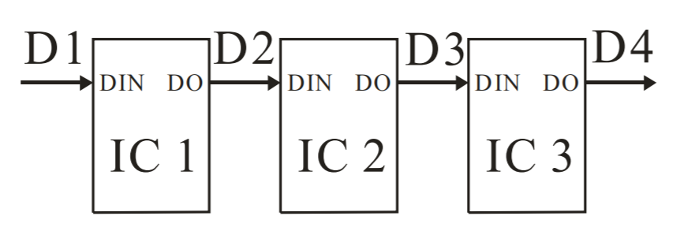
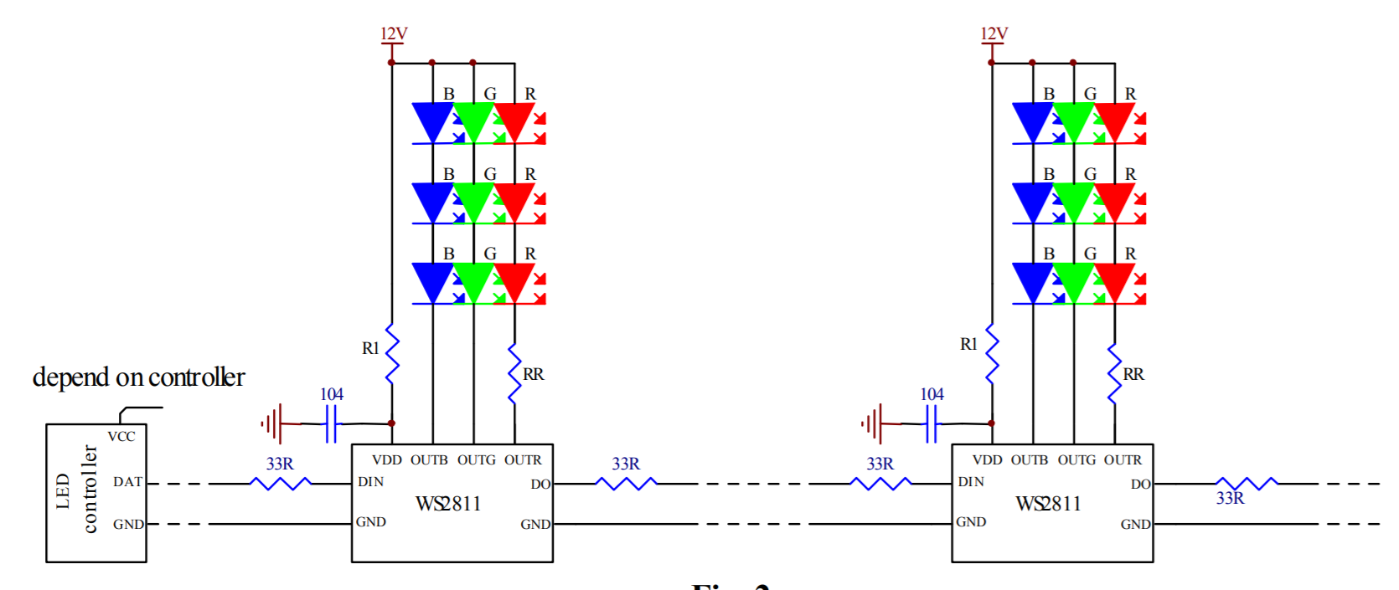
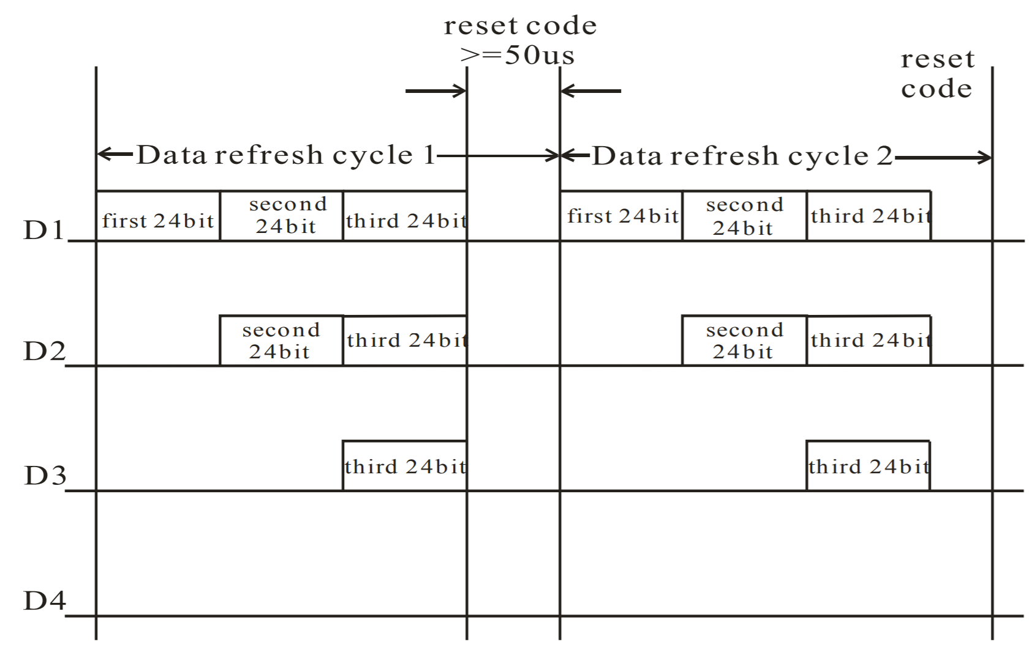
Hardware platforms used
Hardware:
Raspberry Pi
Pi Camera V2
12V 30A power supply
LM2596 - 12V to 5V buck converter
LED light strand (WS2811 chip)
Lazy susan
SDDec19-10
Notes:
Chad
Raspberry Pi - camera pi will do all the image processing and then send the calibration file to the control pi
Pi Camera V2 - easier than using a users cell phone, allows more control protects against variability in users phones
LM2596 - 12V to 5V buck converter
LED light strand (WS2811 chip) - chip used inside LEDs, drives 3 LEDs at 12V. Latches first 24 bits and sends PWM bitstream to next chip
12V 30A power supply - LEDs expected to use max of 45W or 3.75A, full brightness, all white. Pi recommends max 2.5A, shouldn’t come close to that
Lazy Susan - allows the tree to be easily spun for calibration

Slide 17
Hardware platforms used
Hardware:
Raspberry Pi
Pi Camera V2
12V 30A power supply
LM2596 - 12V to 5V buck converter
LED light strand (WS2811 chip)
Lazy susan
SDDec19-10
Notes:
Chad
Raspberry Pi - camera pi will do all the image processing and then send the calibration file to the control pi
Pi Camera V2 - easier than using a users cell phone, allows more control protects against variability in users phones
LM2596 - 12V to 5V buck converter
LED light strand (WS2811 chip) - chip used inside LEDs, drives 3 LEDs at 12V. Latches first 24 bits and sends PWM bitstream to next chip
12V 30A power supply - LEDs expected to use max of 45W or 3.75A, full brightness, all white. Pi recommends max 2.5A, shouldn’t come close to that
Lazy Susan - allows the tree to be easily spun for calibration

Slide 18
Software platforms used
Software:
OpenCV
PySwarm
NeoPixel
Pi camera API
PHP/HTTP server
SDDec19-10
Notes:
Jake

Slide 19
Calibration
Inputs
Number of LEDs
Height of tree
Number of sides to scan
Distance from the tree
Images of the tree
Output
Notes:
jake

Slide 20
Calibration - Phase 1 LED Detection
What it’s doing
Take a picture
Apply a filter
Remove anything not within the color range
Find the ‘contours’
Return the midpoint of the countour
Outputs
[ { LED #, rotation, (x,y) } , ... ]
Notes:
Jake

Slide 21
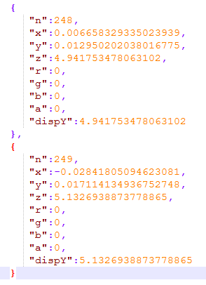
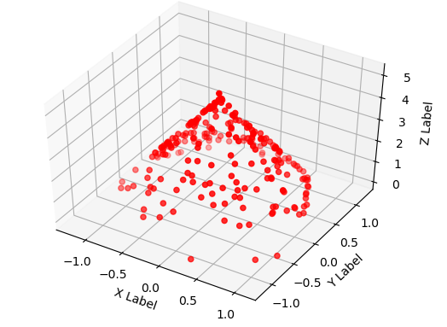
Calibration - Phase 2 TreeSolv
What it’s doing
Convert LED (x,y) and Psi values to (x,y,z)
Utilizes PySwarm
Outputs
JSON file containing LED #, (x, y, z, psi) , (r, g, b, a)
Notes:
For the second phase of the calibration sequence, we take the output of phase one and use it as inputs of the TreeSolv.py script. This script utilizes PySwarm, a particle swarm optimization library for python to calculate the best location for each LED from each ‘hit’ that an LED received. For example, if an LED was seen at 0 degrees, 45 degrees, and 90 degrees, we had to take that degree rotation into account so that the resultant value was similar for all three points. In the end, we expect the input x,y data to be transformed into (x,y,z) values based on numerous inputs such as the Camera Height, Distance, and Angle, as well as the tree height, radius, image x,y coordinates and rotation value. For the outputs, we have a 3d model of the tree just to see if everything ‘looks’ as it should, and then the JSON output that is fed to the web app. This json data is used throughout the entire web app when saving and loading the patterns by simply setting the RGBA values.

Slide 22
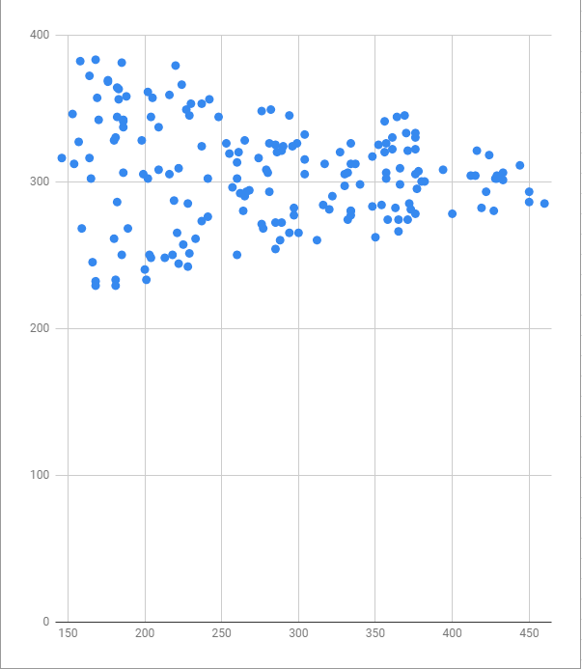
Calibration Challenges
Phase 1
Choice of detection Color
Integrated Communication
Phase 2
Re-Bounding the tree from 0 to 2π, to -2π to 2π
Handling the coordinate
2d image coordinates
3d cone coordinates
Determining if data from Phase 1 was valid
Blue Attempt
Red Attempt
Notes:
Phase 1 - jake
Phase 2 - Joe
The first issue faced with the calculation process of the calibration sequence was Re-Bounding the tree from 0 to 2π, to -2π to 2π. The reasoning for this was because PySwarm was calculating points right on the edge of the tree, 2π, and stopping rather than rolling over. This would create a line on the side of tree of ‘stuck’ points.
A second issue was converting from 2d image coordinates, where the coordinates would start at 0,0 in the top left, to 3d coordinates which start at 0,0 from the bottom left.
Finally, we had to verify that the data received from part 1 was actual valid data.
The data shown here is just a sample of the output. We would expect this data to be centered, rotated, and then transformed to handle the change in coordinate systems.

Slide 23
User Interface
Notes:
jake

Slide 24
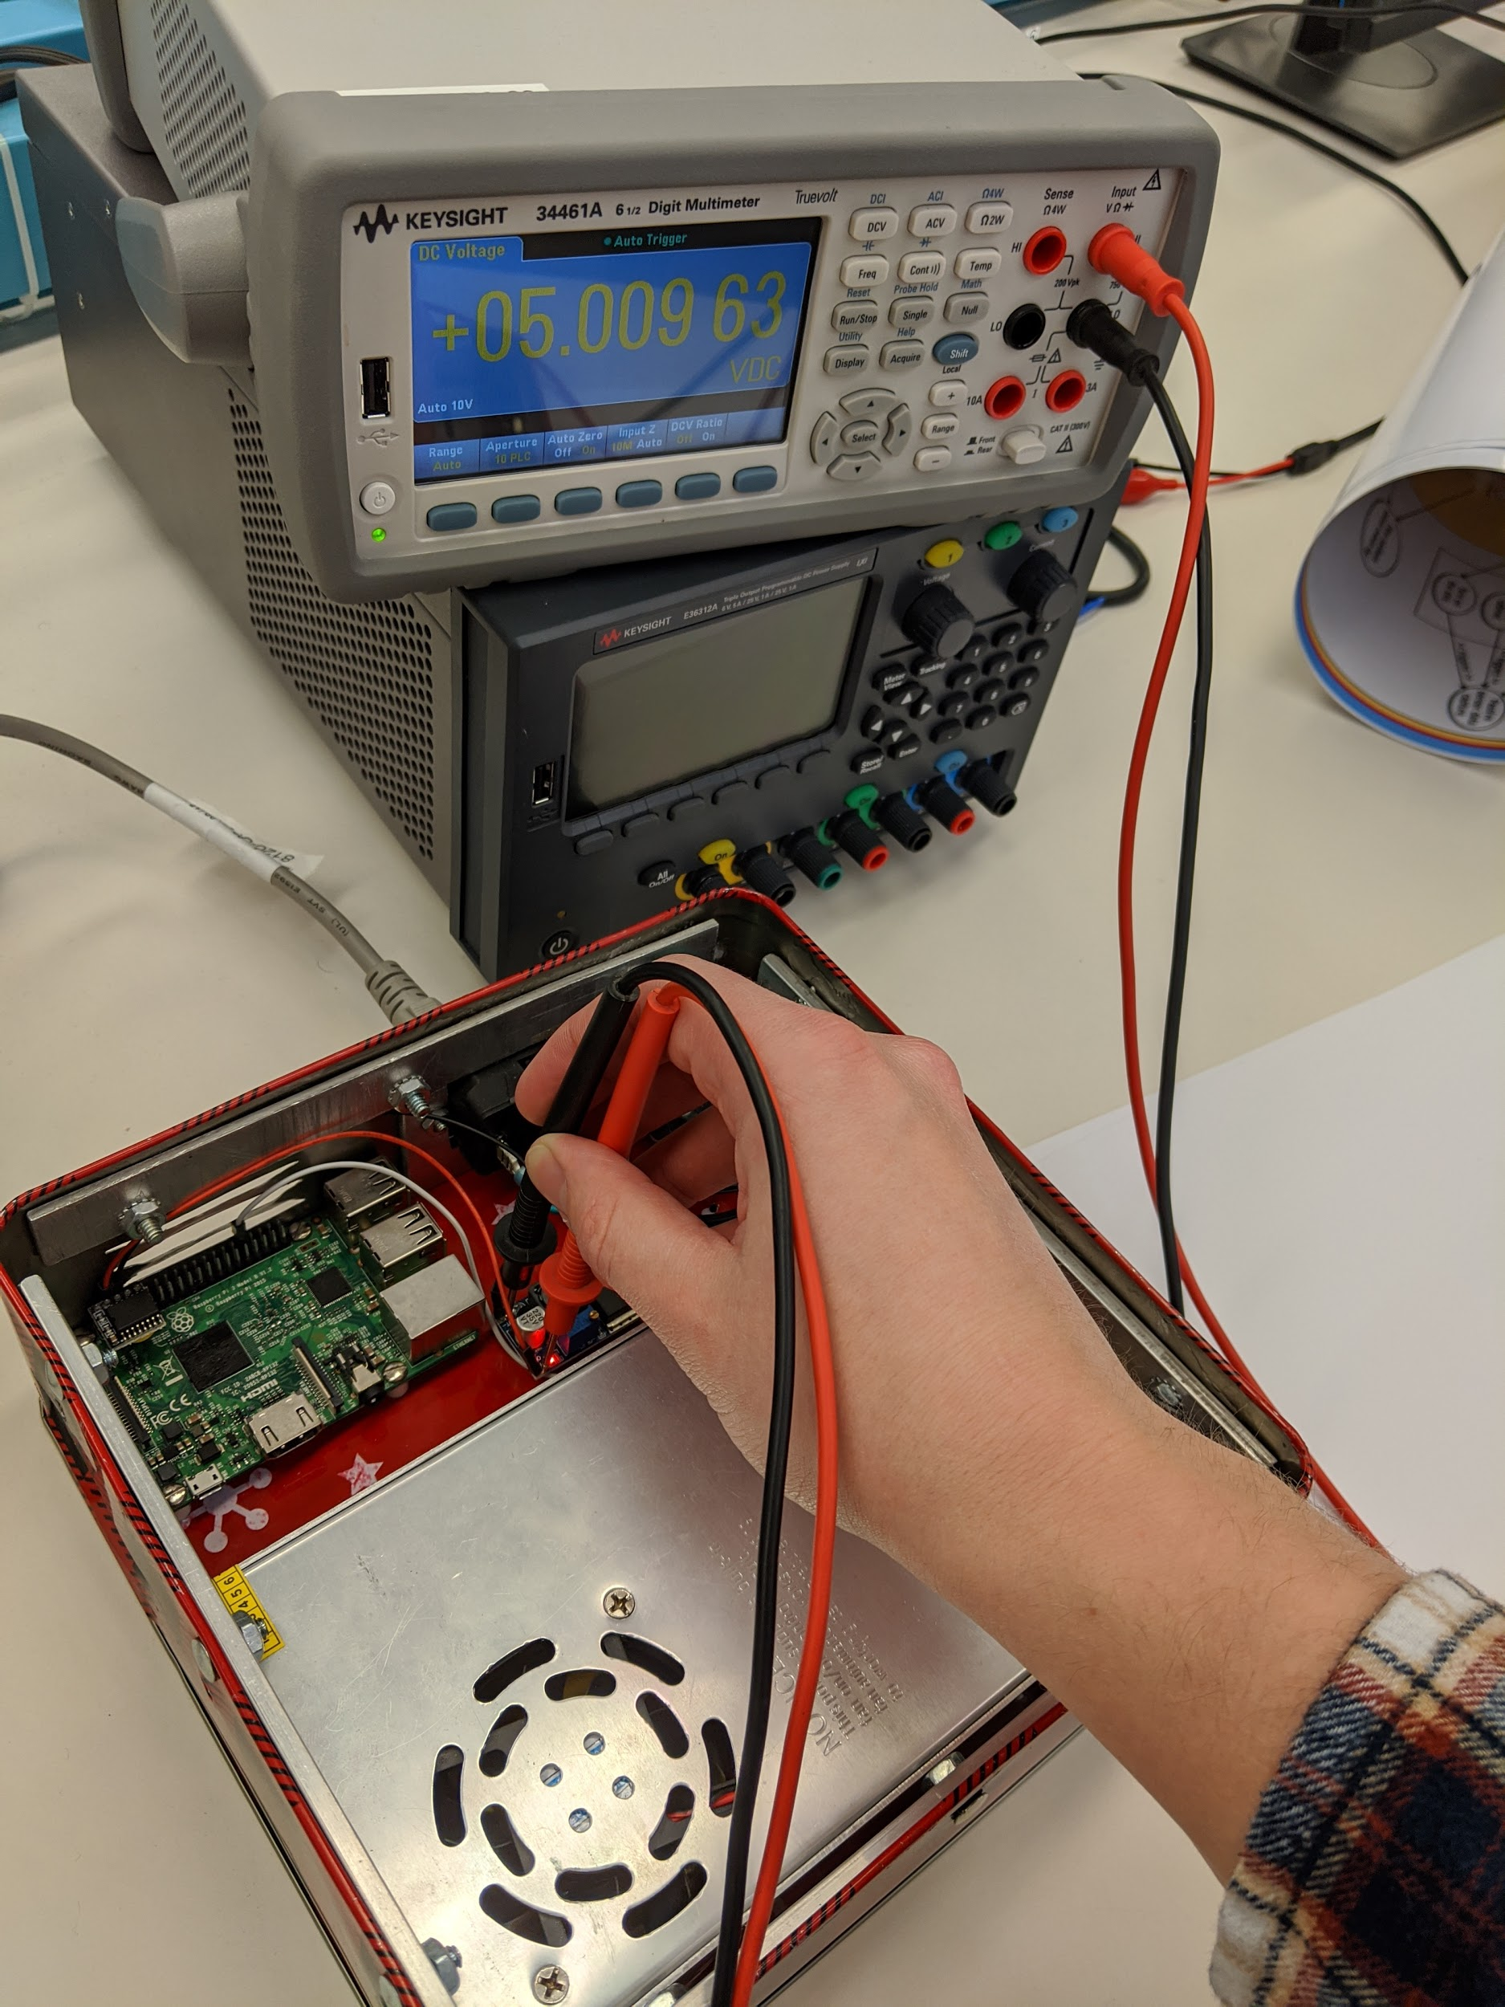
Test Plan
Software
Confirm Interactions with Hardware
Server & Client makes connection
Establish accurate calibration
Handle uploaded image files for lights
Bug-free
Hardware
Verify voltage levels during use
120V Source → 12V Power Supply
LM2596 Chip 12V → 5V
Let the system run for several hours
Monitor temperature
SDDec19-10
Notes:
Software - Joe
Hardware - Val

Slide 25
Prototype Implementation
SDDec19-10
Notes:
N/A

Slide 26
Challenges and Lessons Learned
Using SMPS rather than linear regulator
Heat issues
Setup WAP
Interfaces between different languages (PHP, Python)
Python versions 3.4 vs 3.7
Notes:
Steve

Slide 27
Future Work
Expand to allow arbitrary shapes
Higher light density
Improve animations
Texture/image mapping
Fix Python version conflicts
Optimize calibration
Motorize lazy susan
SDDec19-10
Notes:
Val

Slide 28
Questions?

Slide 29
Resource Cost Estimate
Item | Description | Price
Raspberry Pi (1) | To process Pictures of tree and send data to light strand | $35
Raspberry Pi (2) | To store Pictures of tree and prepare for processing | $35
Pi Cam | To get Pictures of the tree | $14
LM2596 | Adj. SMPS - Buck | $2.31
12V Power Supply | To step down supplied 120VAV to usable 12VDC | $18
IEC 320 C14 Standard Power Cable | To supply 120V power from power outlet to the power port and the 12V power supply | $5
Fused Power Port | To supply protected 120V power from a power outlet to the 12V power supply | $1.50
Light Strand | To display patterns on a holiday tree | $15
SDDec19-10

Slide 30
Resource Cost Estimate (cont)
Item | Description | Price
Wires | To interconnect circuit components | $0.50
Metal Case | To protect internal Pi, power supply, voltage controllers, and wiring from environment | $0
Camera Pi Case | To protect the camera Pi from the environment | $0.50
Tripod | To hold the camera Pi steady while taking Pictures | $0
Raspberry Pi (2) Power Supply | To power the camera Pi | $1
SDDec19-10

Slide 31
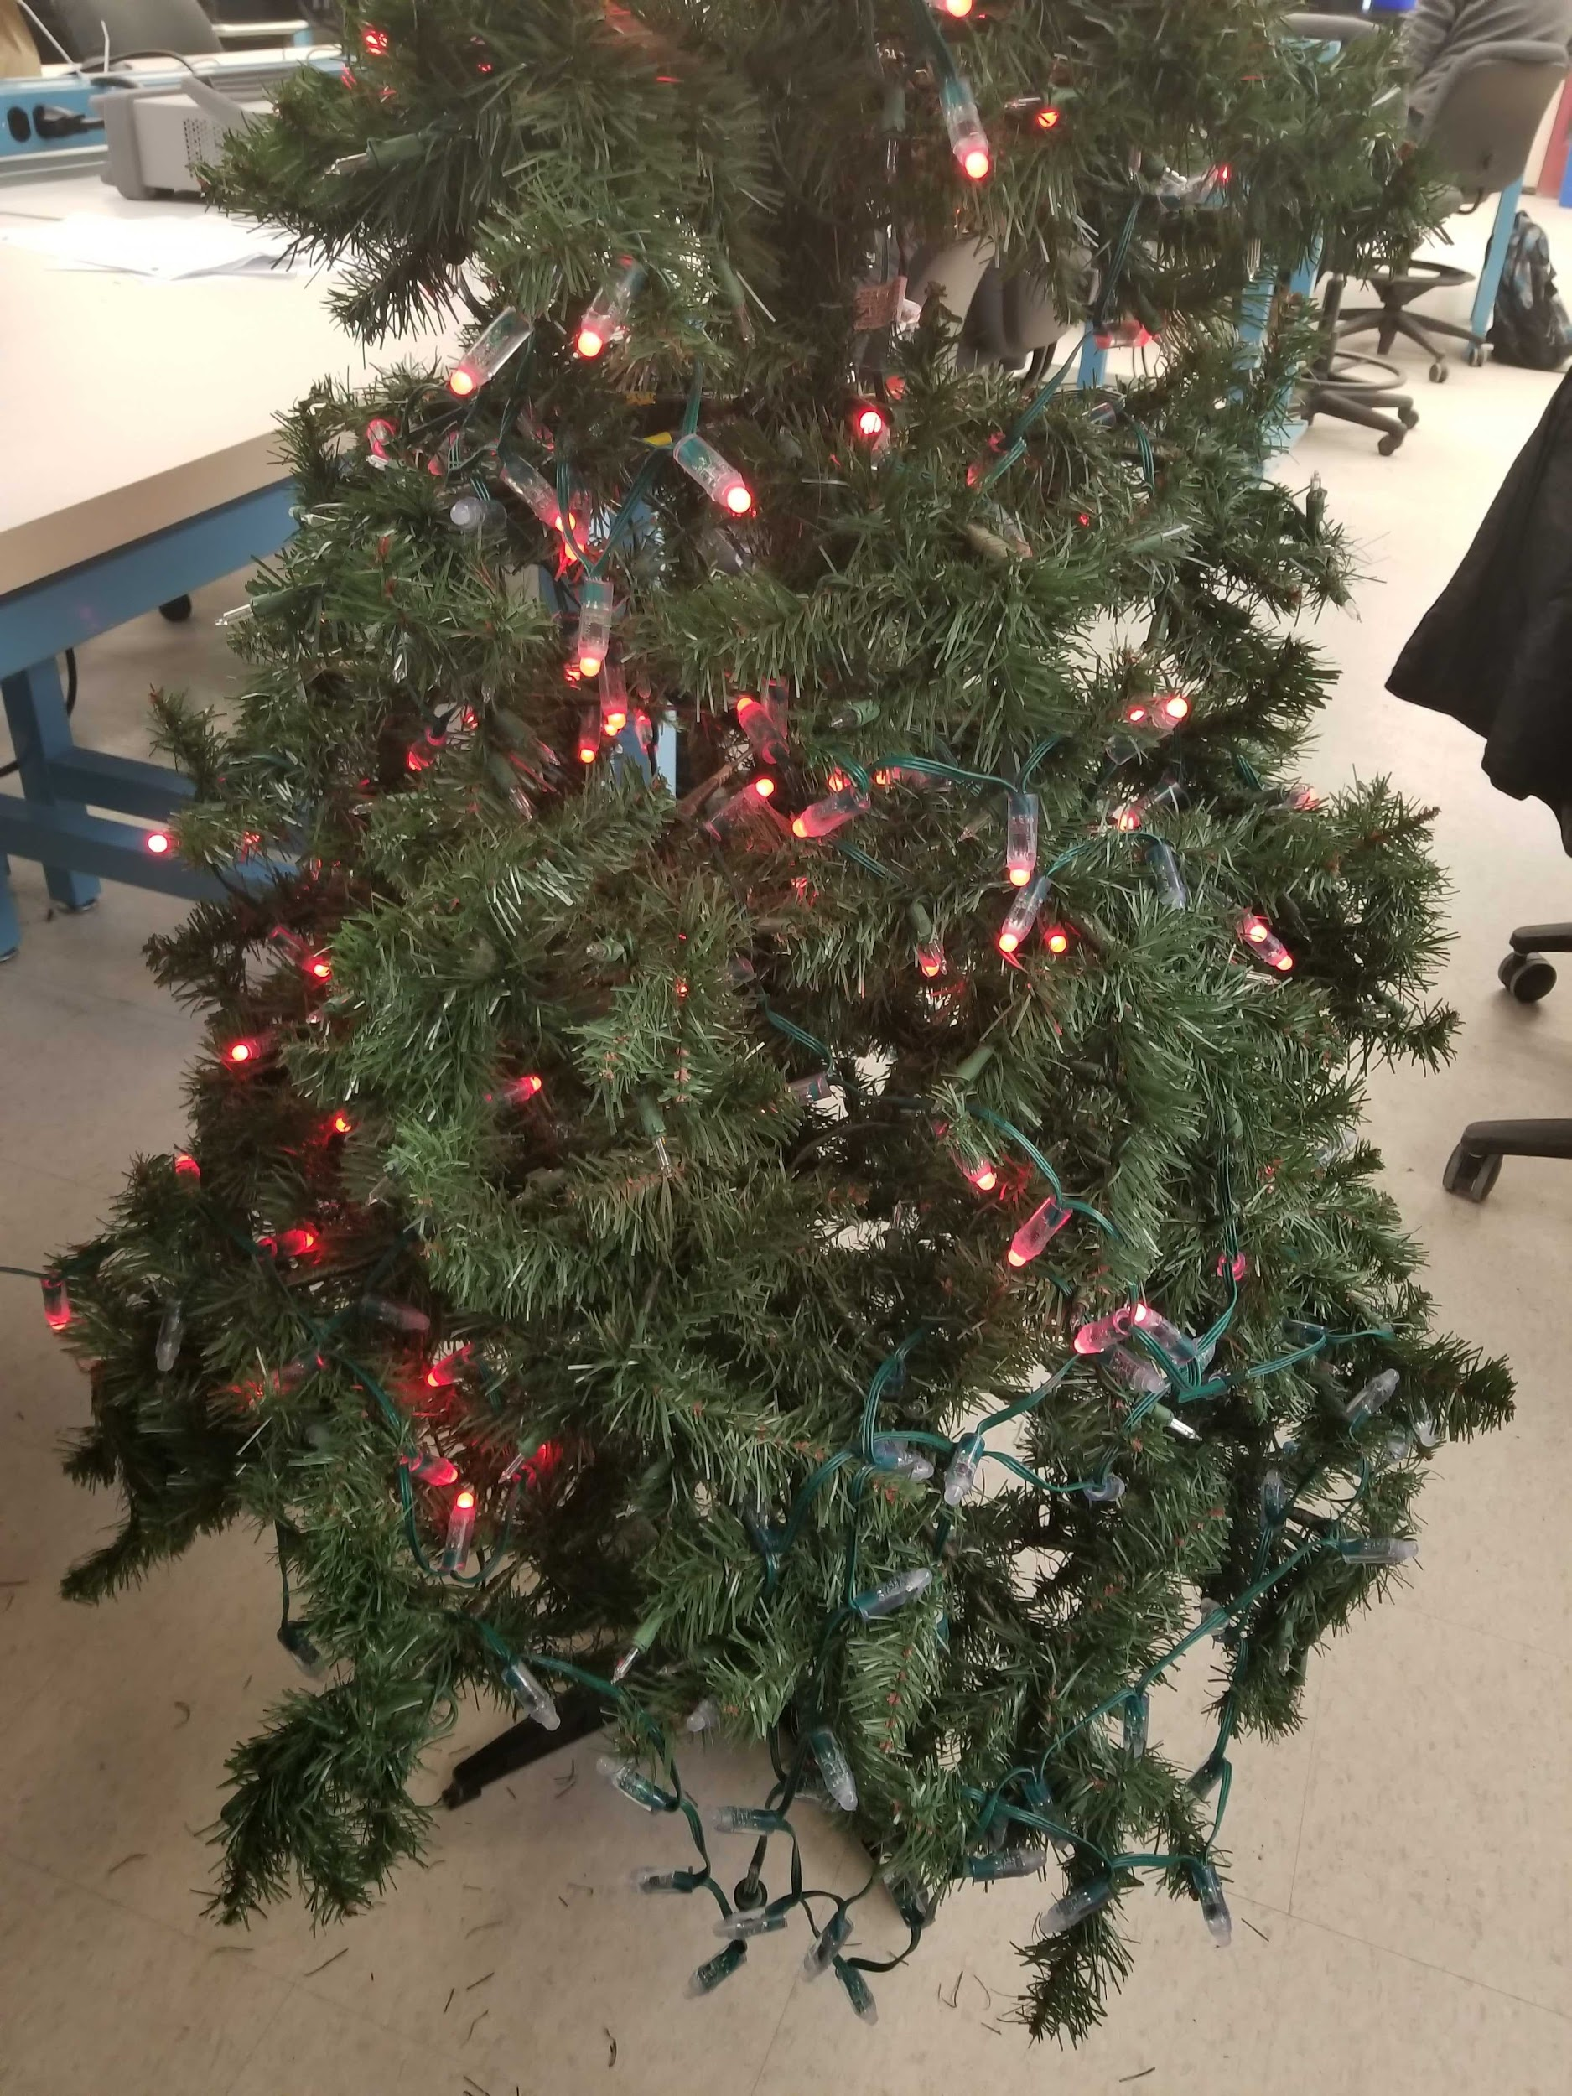
Current Status and Milestones
Milestone 1 (Turn on Lights): Reached April 2nd
Milestone 2 (Patterns and Users): Need to create a Webpage with semi-pre-set patterns
Milestone 3 (Image Uploading): Need to create an image recognition system
Milestone 4 (User Testing): Need to add user-friendliness for connecting to networks
SDDec19-10

Slide 32
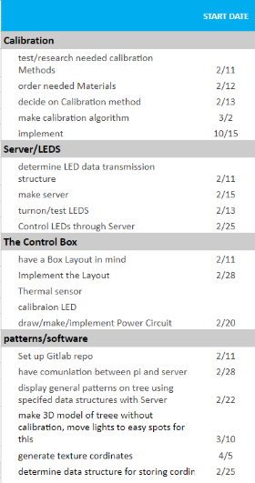
Milestones and Schedule
Turning on the lights using the power distribution system/control box
Displaying a pattern created on the user-interface
Displaying an image uploaded to the user-interface
Testing with users similar to our intended users and having them set-up and use the system
SDDec19-10

Slide 33
Plans for Next Semester
Finalize the auto-calibration of the system
Fully functional web application
Lazy Susan
Fix power issues
Acquire back-up part and parts for stress-testing
Finalize data that will be displayed on LCDs
SDDec19-10

Slide 34
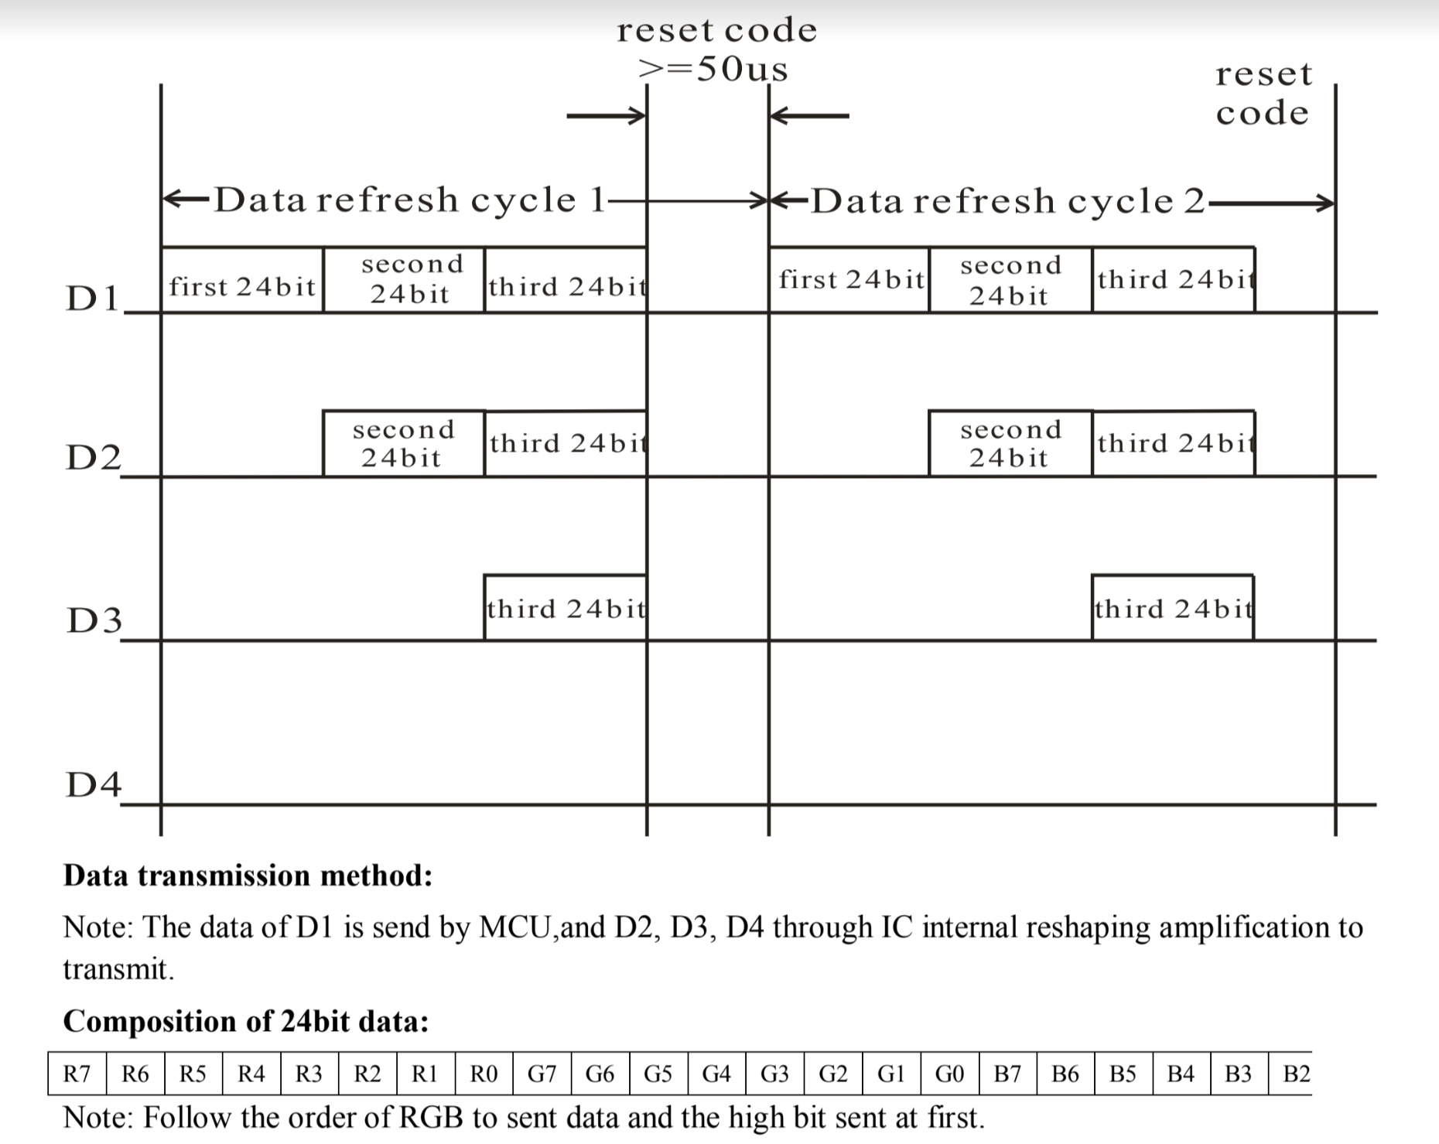
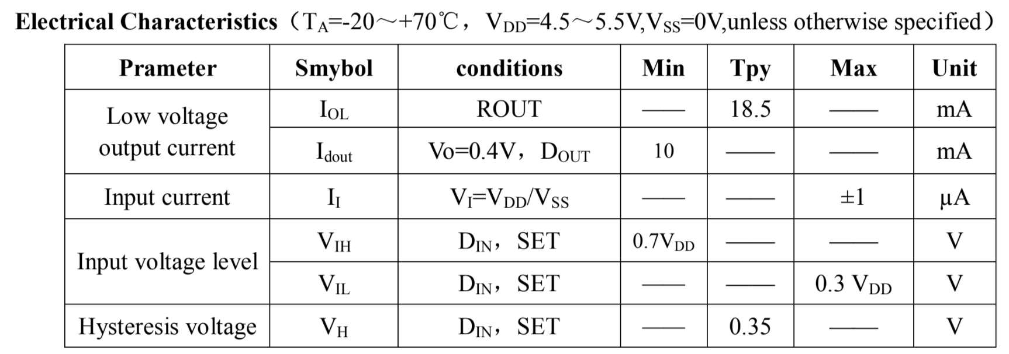
WS2811 Datasheet

Slide 35
